Slide 1
CONIC SECTIONS

Slide 2
SPECIFIC OBJECTIVES:
At the end of the lesson, the student is expected to be able to:
• define conic section
• identify the different conic section
• describe parabola
• convert general form to standard form of equation of parabola and vice versa.
• give the different properties of a parabola and sketch its graph

Slide 3

Conic Section or a Conic is a path of point that moves so that its distance from a fixed point is in constant ratio to its distance from a fixed line.
Focus is the fixed point
Directrix is the fixed line
Eccentricity is the constant ratio usually represented by (e)

Slide 4
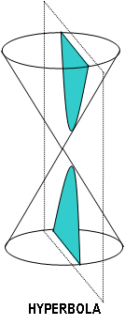
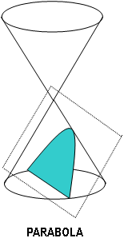
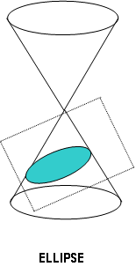
The conic section falls into three (3) classes, which varies in form and in certain properties. These classes are distinguished by the value of the eccentricity (e).
If e = 1, a conic section which is a parabola
If e < 1, a conic section which is an ellipse
If e > 1, a conic section which is a hyperbola

Slide 5
THE PARABOLA (e = 1)
A parabola is the set of all points in a plane, which are equidistant from a fixed point and a fixed line of the plane. The fixed point called the focus (F) and the fixed line the directrix (D). The point midway between the focus and the directrix is called the vertex (V). The chord drawn through the focus and perpendicular to the axis of the parabola is called the latus rectum (LR).

Slide 6
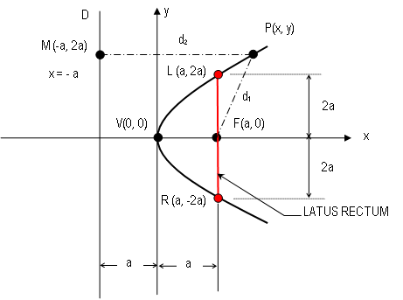
PARABOLA WITH VERTEX AT THE ORIGIN, V (0, 0)

Slide 7




Let: D - Directrix
F - Focus
2a - Distance from F to D
LR - Latus Rectum = 4a
(a, 0) - Coordinates of F
Choose any point along the parabola
So that,
or

Slide 8
Squaring both side,

Slide 9
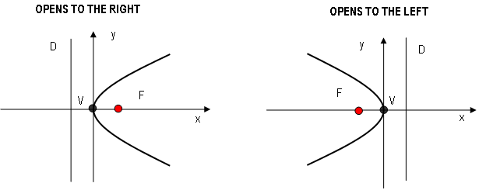


Equations of parabola with vertex at the origin V (0, 0)

Slide 10
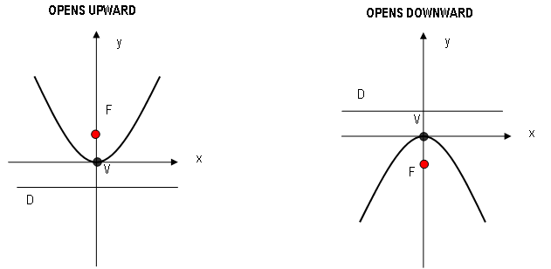



Slide 11
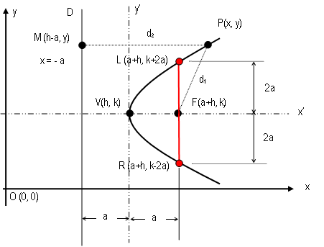
PARABOLA WITH VERTEX AT V (h, k)

Slide 12
We consider a parabola whose axis is parallel to, but not on, a coordinate axis. In the figure, the vertex is at (h, k) and the focus at (h+a, k). We introduce another pair of axes by a translation to the point (h, k). Since the distance from the vertex to the focus is a, we have at once the equation
y’² = 4ax’
Therefore the equation of a parabola with vertex at (h, k) and focus at (h+a, k) is
(y – k)² = 4a (x – h)

Slide 13
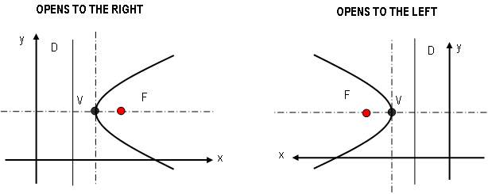


Equations of parabola with vertex at V (h, k)

Slide 14
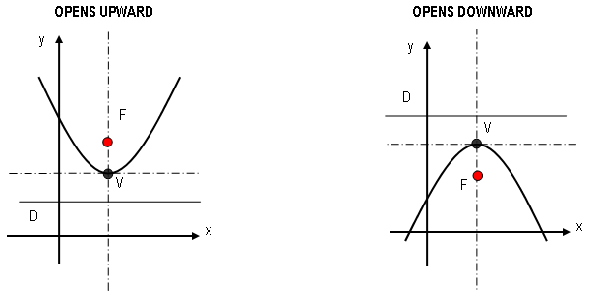



Slide 15


Standard Form General Form
(y – k)² = 4a (x – h)
y² + Dy + Ex + F = 0
(y – k)² = - 4a (x – h)
(x – h)² = 4a (y – k)
x² + Dx + Ey + F = 0
(x – h)² = - 4a (y – k)

Slide 16
Examples
I. Draw the graph of the parabola:
a. 3y² – 8x = 0
b. y² + 8x – 6y + 25 = 0.
II. Determine the equation of the parabola in the standard form, which satisfies the given conditions:
a. V(0, 0) axis on the x-axis and passes through (6, -3).
b. V(0, 0), F(0, -4/3) and the equation of the directrix is y – 4/3 = 0.
c. V (3, 2) and F (5, 2).
d. V (2, 3) and axis parallel to y axis and passing through (4, 5).
e. V (2, 1), Latus rectum at (-1, -5) & (-1, 7).
f. V (2, -3) and directrix is y – 7 = 0.

Slide 17
g. with latus rectum joining the points (2, 5) and (2, -3).
h. With vertex on the line y = 2, axis parallel to y-axis L.R. is 6 and passing through (2, 8).
Application
A parabolic trough 10 meters long, 4 meters wide across the top and 3 meters deep is filled with water at a depth of 2 meters. Find the volume of water in the trough.
A parkway 20 meters wide is spanned by a parabolic arc 30 meters long along the horizontal. If the parkway is centered, how high must the vertex of the arch be in order to give a minimum clearance of 5 meters over the parkway.

Slide 18
A boy with a slingshot, shot a bird flying horizontally at a distance h from the ground with a speed of 12m/min. The boy missed the bird and the bullet of the sling went up to a maximum height h from the level of the bird. When the bullet descended to the range of the projectile, it hit the bird. Find the horizontal component speed of the bullet.

Slide 19
End of Chapter

Slide 20
A parabola whose axis is parallel to the y-axis passes through the points (-1, 1), (3, 4) and (2, -2). Find the equation of the parabola.
A parabolic trough 10 meters long, 4 meters wide across the top and 3 meters deep is filled with water at a depth of 2 meters. Find the volume of water in the trough.
A boy with a slingshot, shot a bird flying horizontally at a distance h from the ground with a speed of 12m/min. The boy missed the bird and the bullet of the sling went up to a maximum height h from the level of the bird. When the bullet descended to the range of the projectile, it hit the bird. Find the horizontal component speed of the bullet.

Slide 21
A parabolic suspension bridge cable is hung between two supporting towers 120 meters apart and 35 meters above the bridge deck. The lowest point of the cable is 5 meters above the deck. Determine the lengths (h1 & h2) of the tension members 20 meters and 40 meters from the bridge center.
A parkway 20 meters wide is spanned by a parabolic arc 30 meters long along the horizontal. If the parkway is centered, how high must the vertex of the arch be in order to give a minimum clearance of 5 meters over the parkway.

Slide 22
End of Discussion

